Slide 1

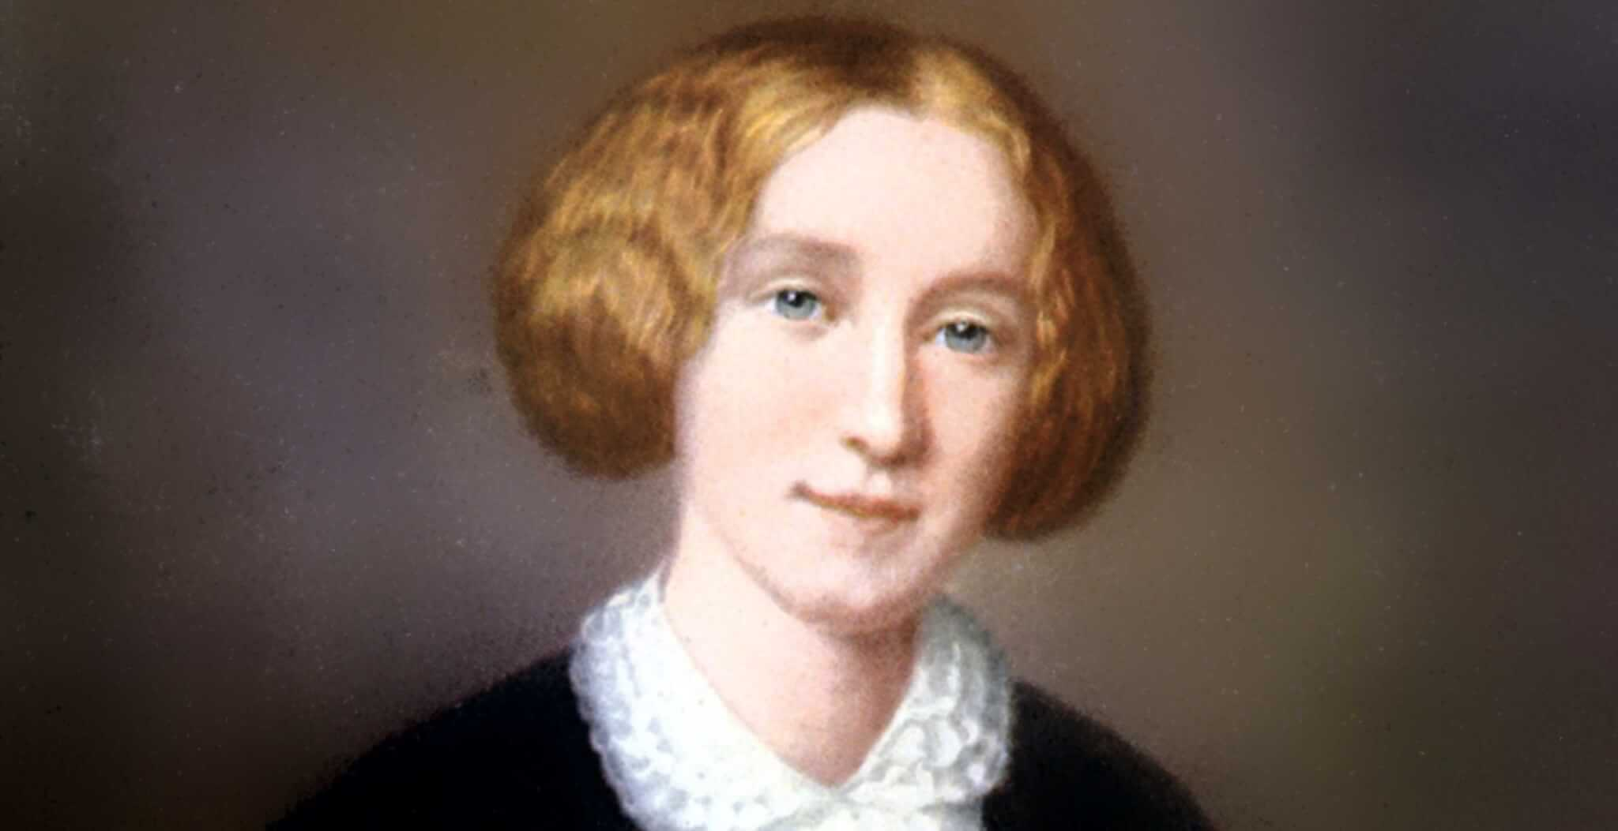
The George Eliot Archives
Team 6a
Project Sponsor:
Beverley Park Rilett, Ph.D.
Project Devs:
Brad Hughes (Developer) Ravindra Joshi (Grad Student)
Senior Design Member:
George Martin

Slide 2
System Metaphor
The George Eliot Archive is a digital humanities project and website used by scholars, researchers, and students when looking into the life of author George Eliot.
George Eliot is the pen name of Mary Ann Evans that she maintained throughout her life. The website hosts all of George Eliot's public literary works, articles about her, and intimate verifiable details regarding her life.
The website's intent is to be the most complete, accurate, and trusted source for researchers interested in George Eliot. The exhibit is designed to not only host verified information about George Eliot, but to display it in an interactive (dynamic) and visually appealing way for easy referencing and research.

Slide 3
Project Description (03/22/23)
I will be working under the direction of Dr. Bev and given project focus and tasking that is subject to change throughout the semester. Our currently agreed upon goals for this semester are listed below:
(Cycle 1) – Develop a proof of concept that will allow users to view and search the George Eliot journals on the site (private view). – COMPLETED
(Cycle 2) – Refine the proof of concept into a fully functioning version that is able to display professionally formatted and real time updates to the journals. (publish to live site) – PARTIALLY COMPLETED
(Cycle 3) – Engineer a way to pull data from a static source .csv file to a dynamic source web-host database in order to facilitate real-time updates and up-to-date information. – IN PROGRESS

Slide 4
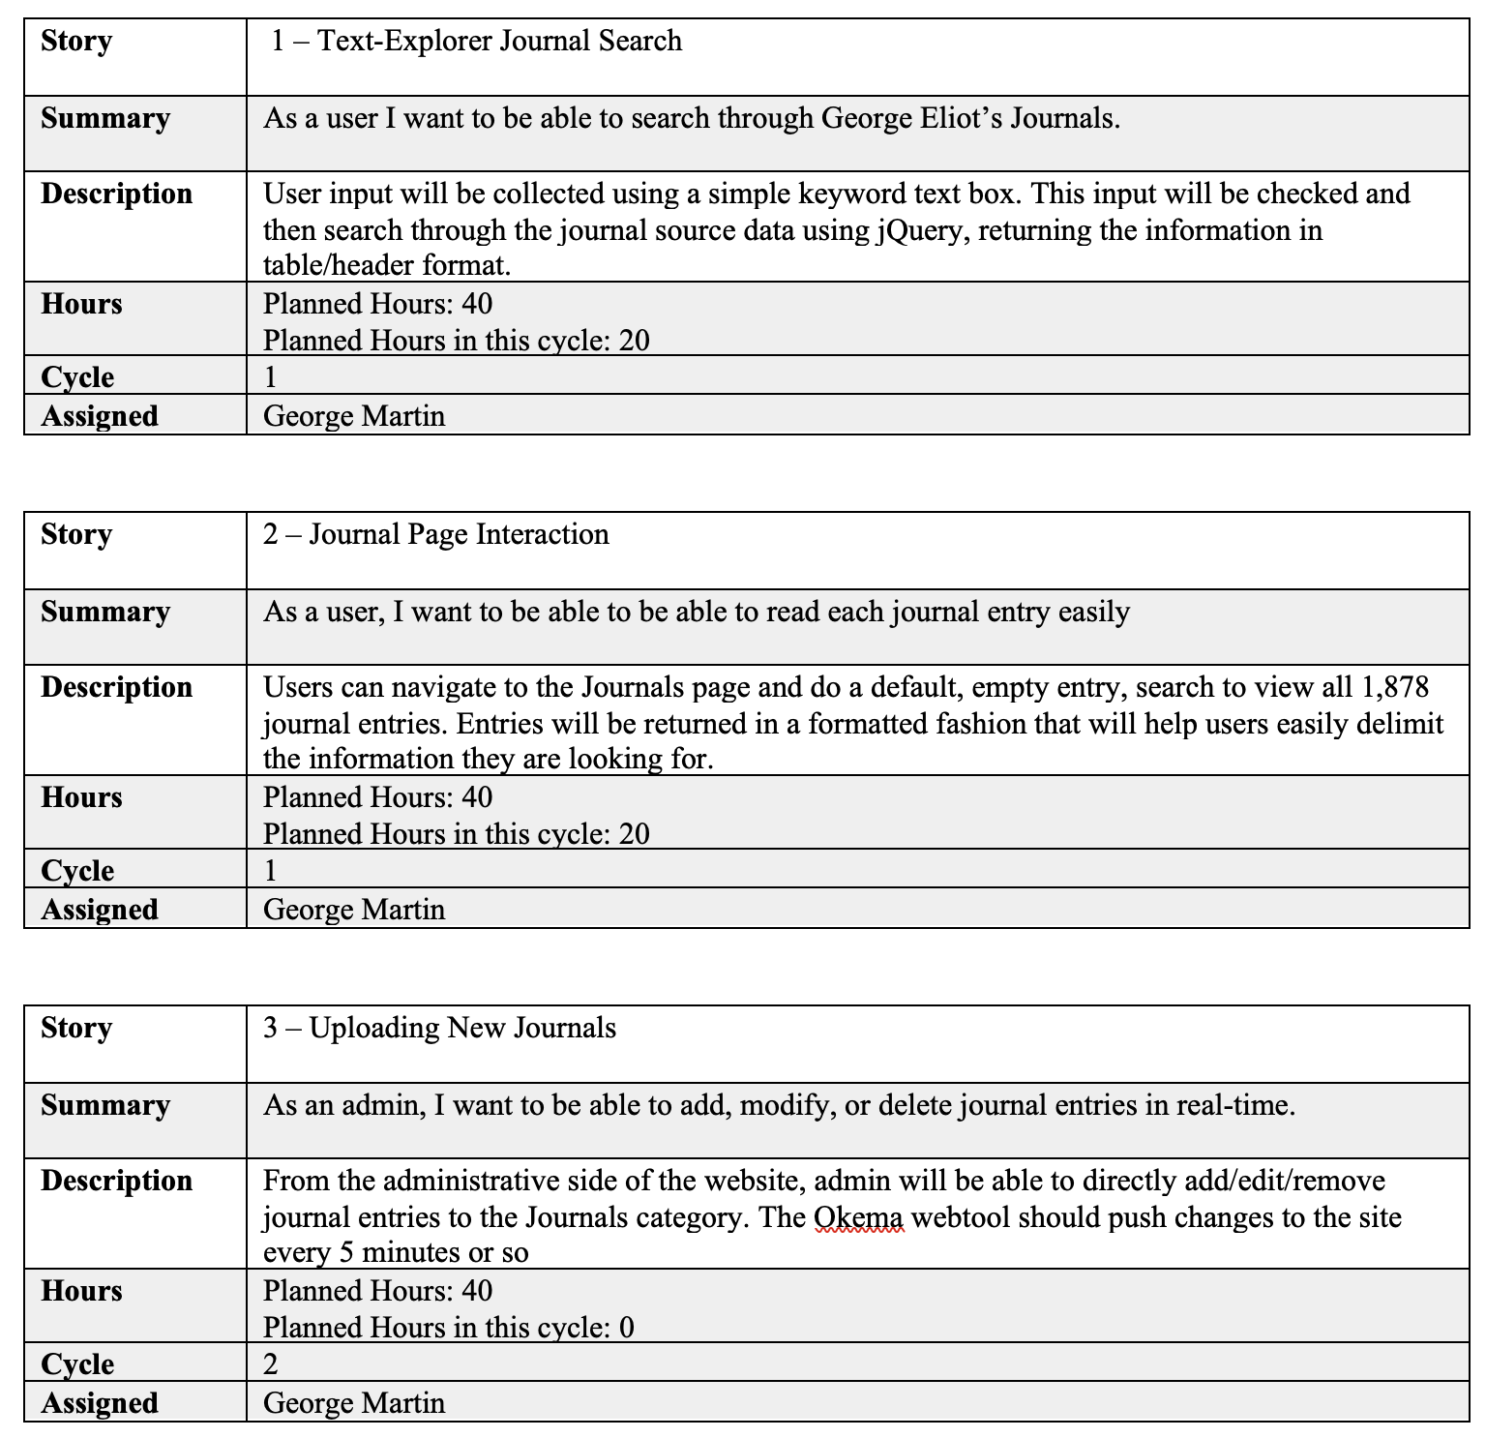
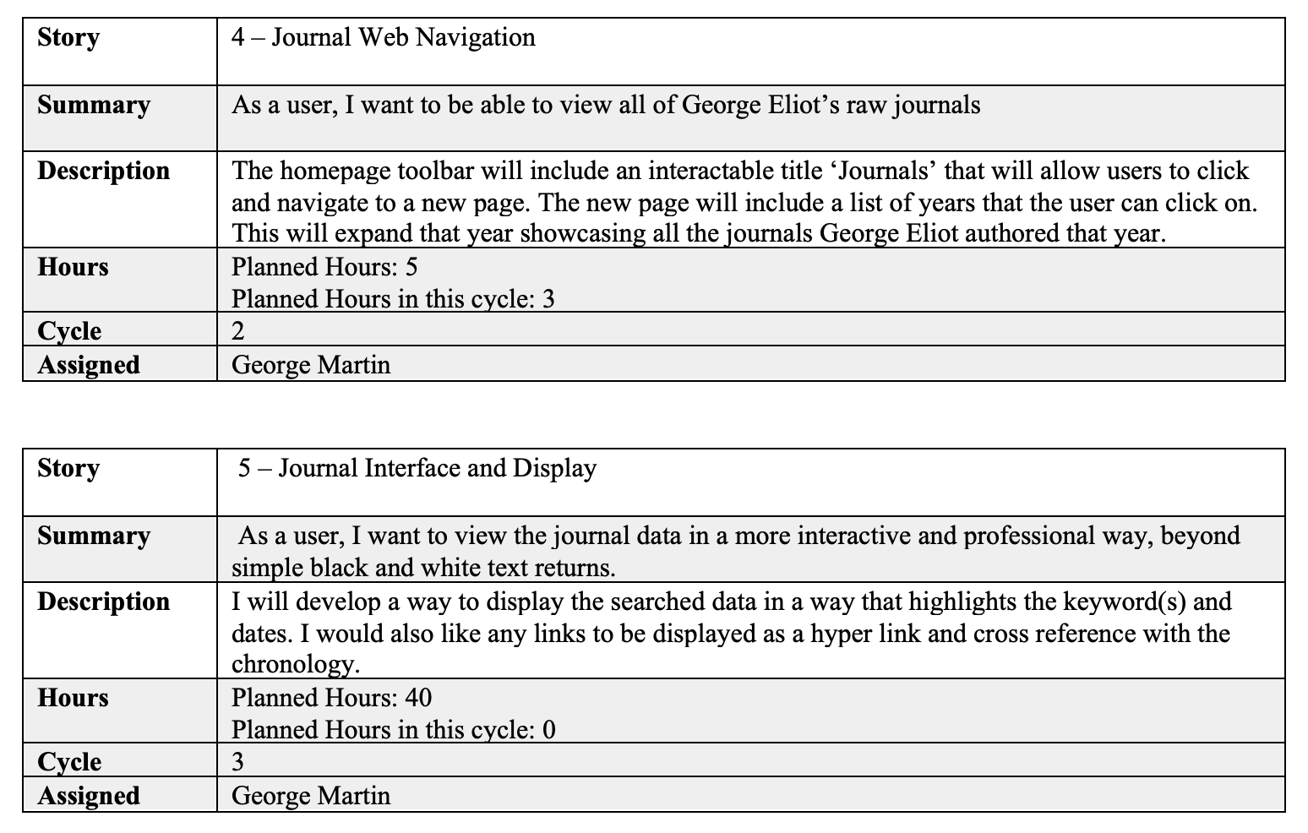
User Stories

Slide 5
Cycle 2 Intent:
Integrate solution to the web-page and publish it so users can begin to review and search through all of the George Eliot Journals. Create a Navigational Toolbar that allows users to easily access the web-page and featured functionality. Solve all formatting issues so new-lines do not overflow into new rows.

Slide 6
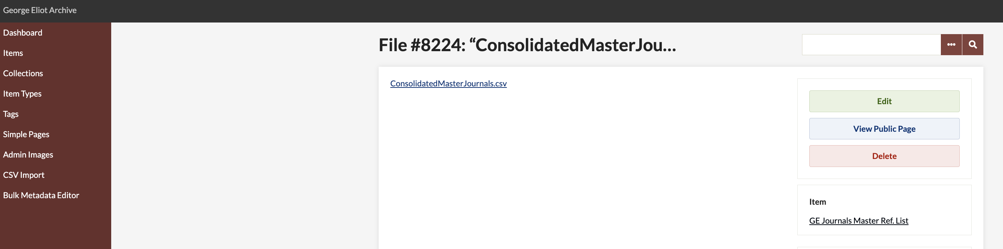
Cycle 2 Review
The journals tab was integrated onto the site to allow users to navigate to the search solution from the toolbar.
All formatting issues were solved so that data does not overflow into new rows when the reader hits a ‘/n’ character.
.csv file containing all 1,878 journal entries.
Collections GH Page

Slide 7
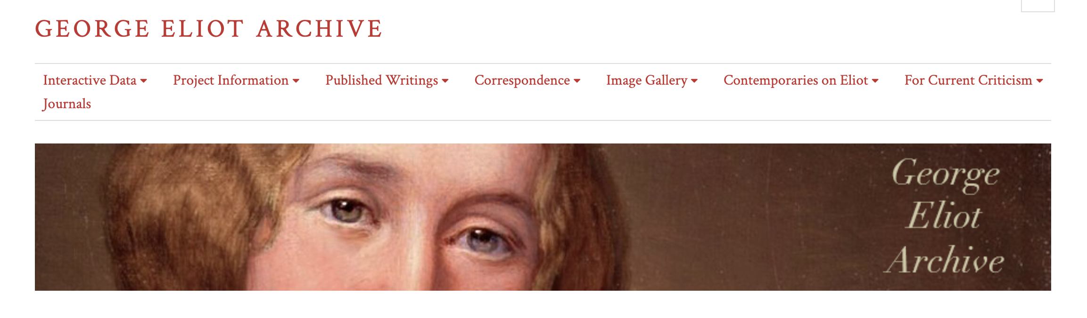
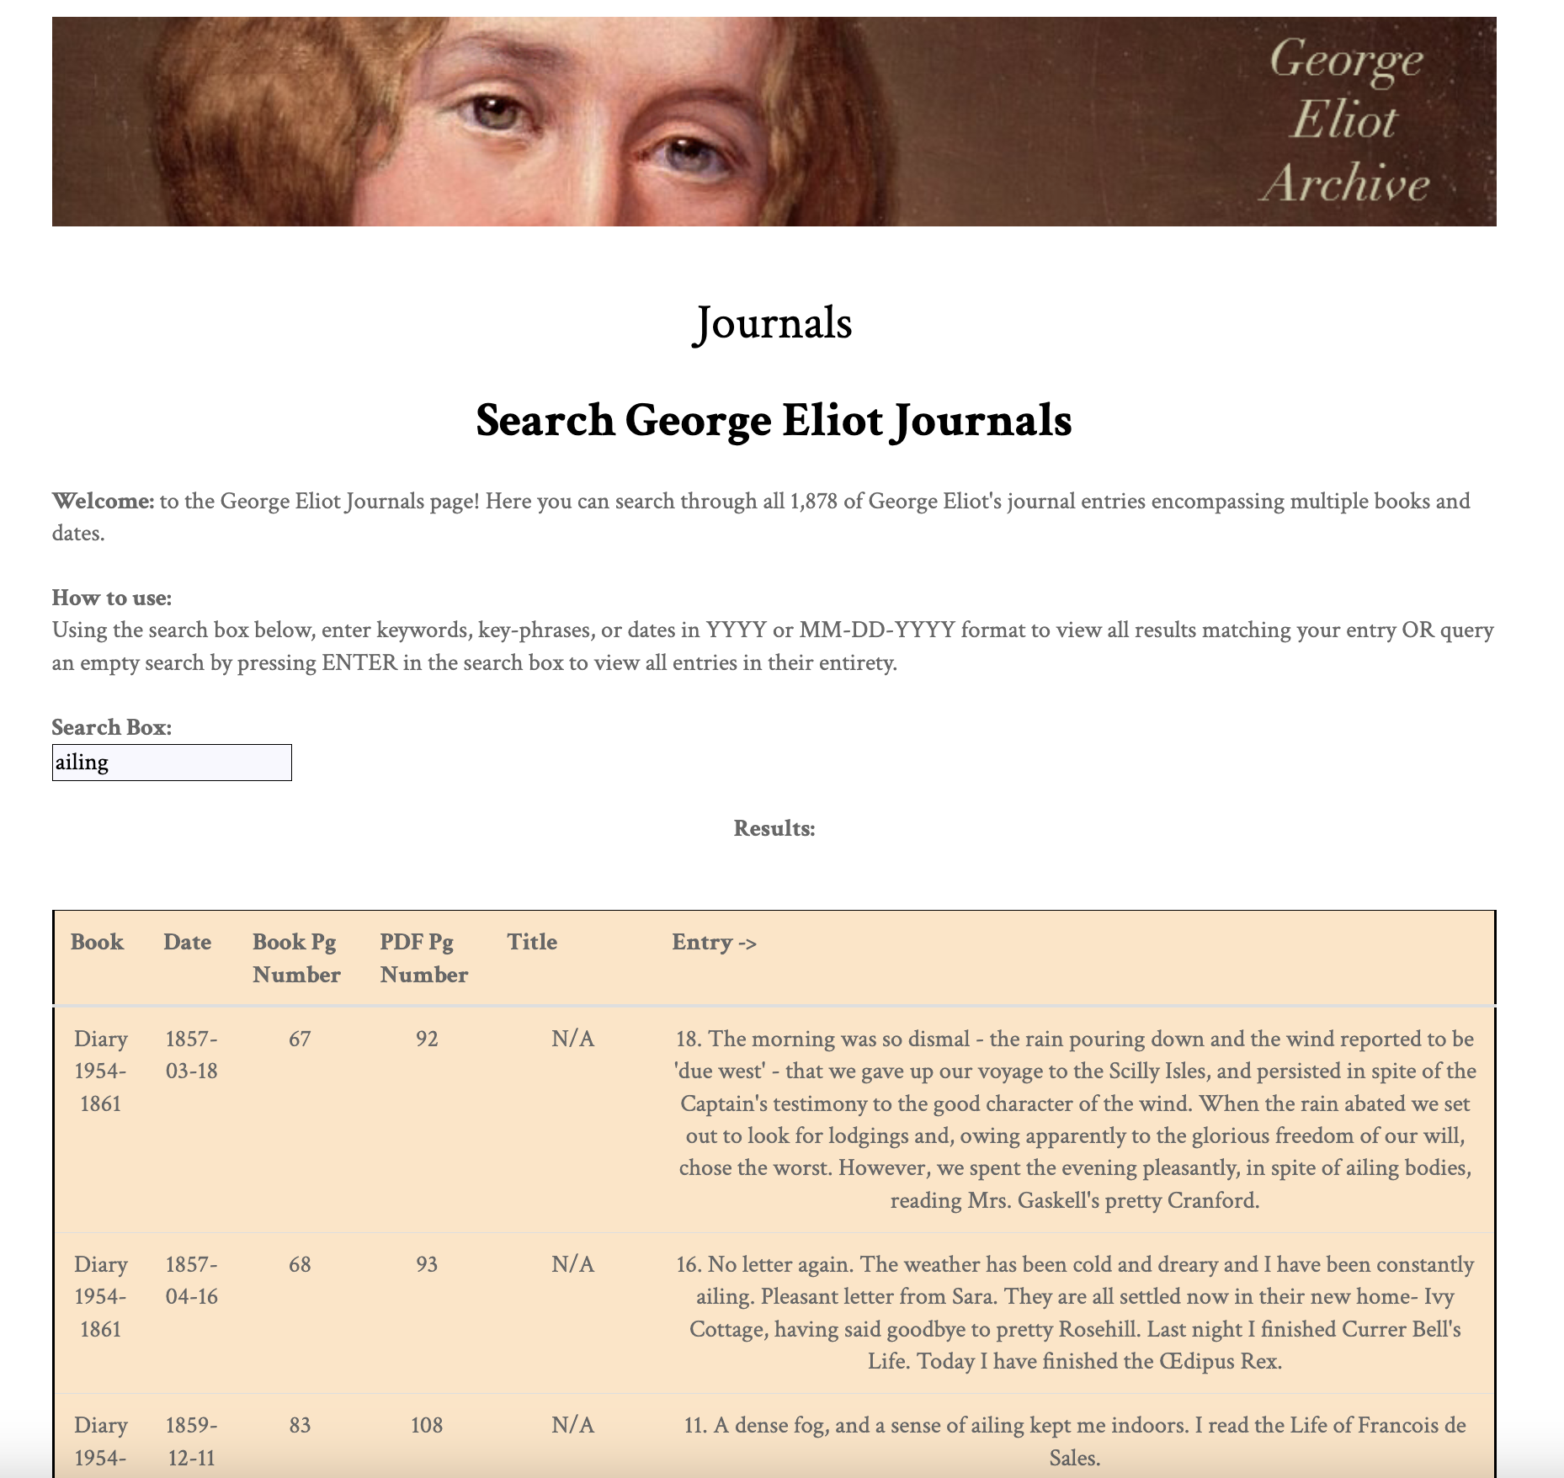
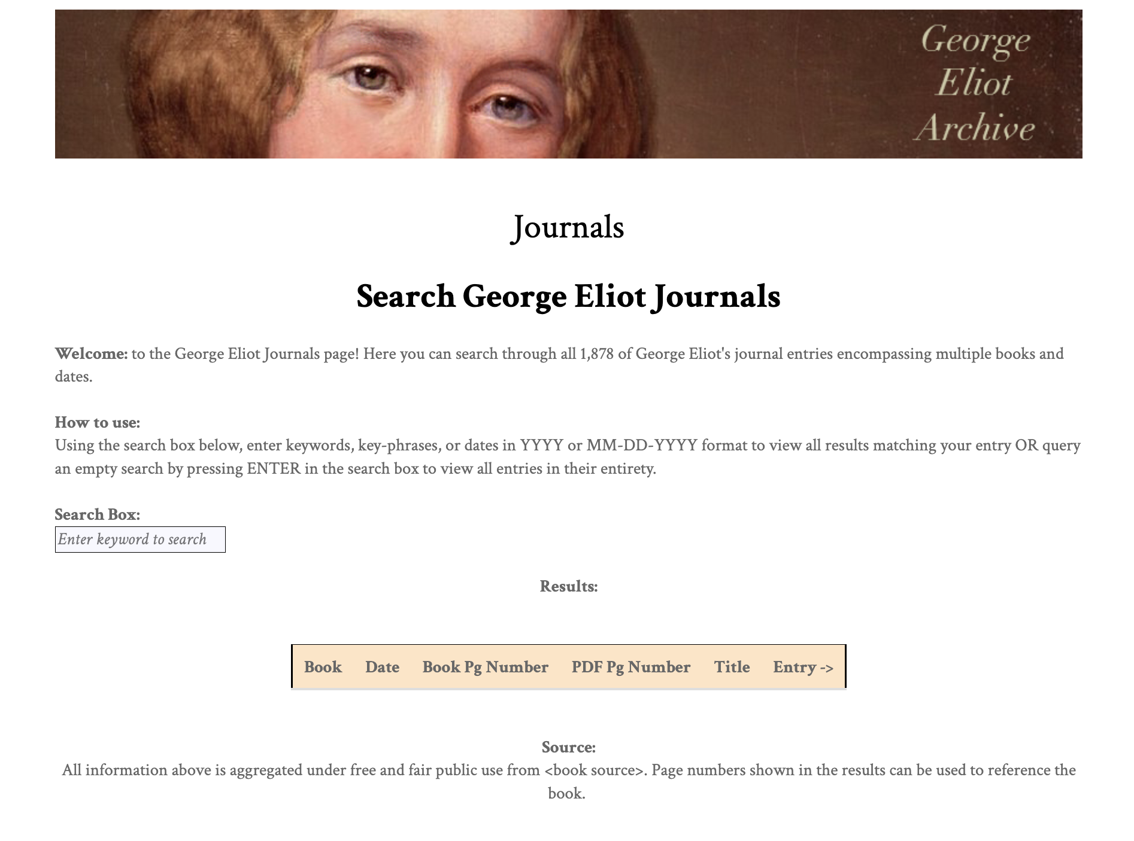
Design Flow

Slide 8
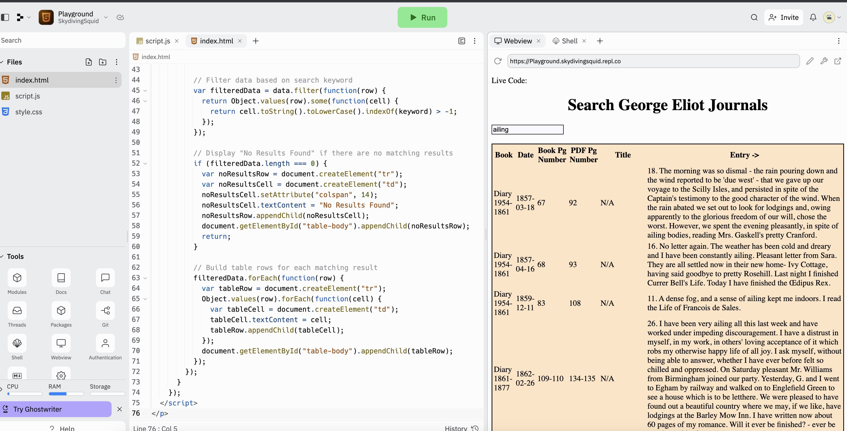
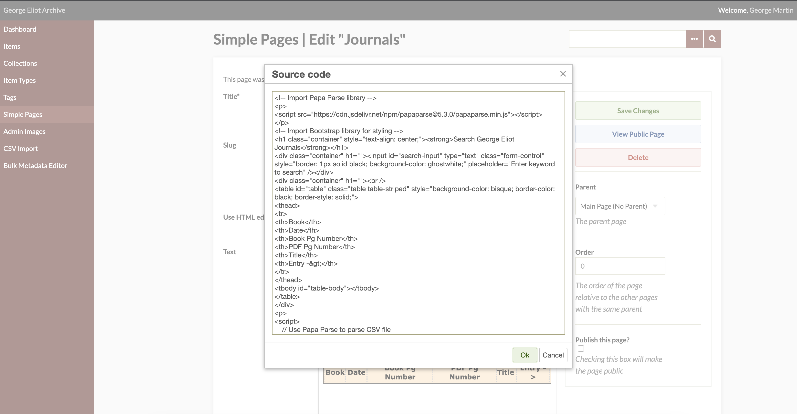
Coding Platform
Replit.com playground to see code before merger.
Coding interface on the live host-site.

Slide 9
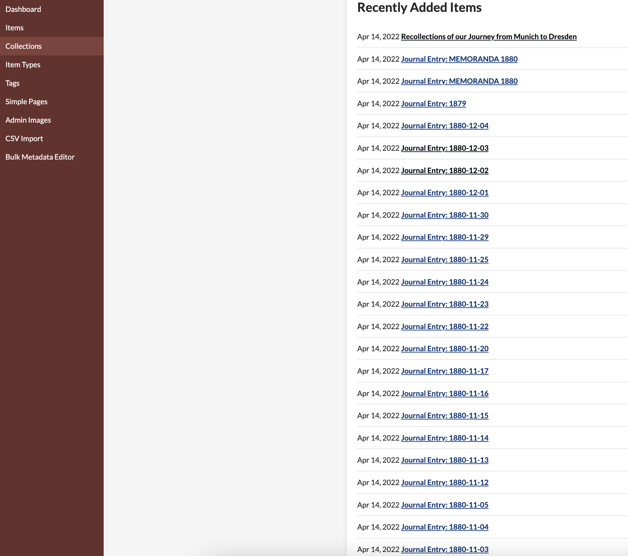
Cycle 2 Issues / Lessons Learned
Remaining issues:
Dr Bev expressed interest to have real-time updating. Currently data is displayed from .csv file URL. The URL changes anytime an update (rare) is made.
This requires an admin to update the URL in the code… Real time will require completely a new & complex solution that pulls from web-hosted source vice .csv file source. ^ This will be the primary focus during Cycle 3.
Every entry is an individual URL.. Instead of a new row in a .csv file..

Slide 10
Plan
Cycle 3: Meet with Brad and Ravindra to review and discuss how the chronology pulls from the web-host and determine if a feasible solution to web-hosted data is possible. Develop a solution similar to the above for Journal search and display. Concerns: *Timeliness of search results *Data aggregation *Formatting

Slide 11
Further Design Details
Language
This project will be utilizing a combination of Javascript, PHP, and CSS for this web-development project
Web-Tools and Resources
The George Eliot Archives uses several resources for hosting and collaboration. Front-end site: https://georgeeliotarchive.org/ Back-end site: https://georgeeliotarchive.org/admin/ A webhost of all journals: https://georgeeliotarchive.github.io Senior Design Documentation: https://auburn.app.box.com/ Public Github Repo: https://github.com/GeorgeEliotArchive
Data Sourcing
Redevelop a solution that pulls data from the web-host instead of a static .csv file. This will be the primary focus of cycle 3.
Functionality is already in place. Only sourcing needs to be changed for full marks.
New Navigational Tab
A 'Journals' category will be added to the homepage of the George Eliot Archives. This tab will allow users to navigate to a new page which will display George Eliot's journals by year -> month.
(Completed ahead of schedule, currently in private-view)

Slide 12
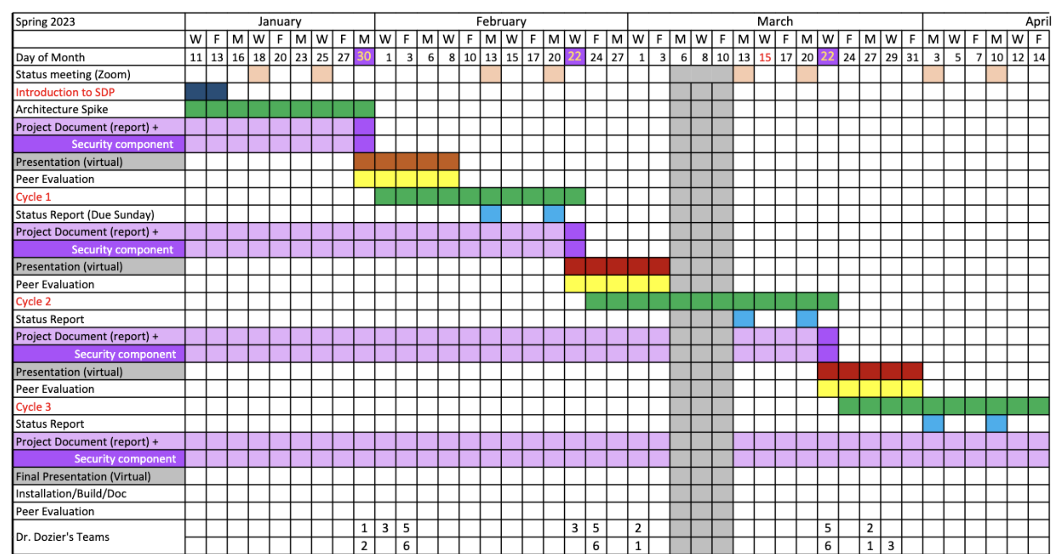
Class Schedule
YOU ARE HERE

Slide 13
Demo
George Eliot Archives
George Eliot Archives - Administration
Backend Collections

